Slide 1
JSON in SQL Server

Slide 2
Some NVARCHAR JSON data
CREATE TABLE #ImportedJson
(
Id int IDENTITY,
JsonValue nvarchar(max)
);
GO
INSERT INTO #ImportedJson (JsonValue)
VALUES (N'{
"Property1" : "Value2",
"Property5" :
{
"SubProp1": "A",
"SubProp2":
{ "SubSubProp1":"B", "SubSubProp2": 1.2, "SubSubProp3" : true
}
},
"Property6" : [{"ArrayProp":"A"},{"ArrayProp":"B"}]
}');
INSERT INTO #ImportedJson (JsonValue)
VALUES (N'{
"Property1" : "Value1",
"Property2" : [1,2,3]
}');
INSERT INTO #ImportedJson (JsonValue)
VALUES (N'{
"Property8" : "Not null",
"Property9" : [4,5,6]
}');
Notes:
What’s JSON look like?
Why is it useful?
Why NVARCHAR?

Slide 3

SELECTing Data
SELECT * FROM #ImportedJSON;
Notes:
Data is just text
Can use regular string functions
Can search using LIKE but performance will be terrible

Slide 4

Scalars: JSON_VALUE()
SELECT JSON_VALUE(JsonValue,'$.Property1')
FROM #ImportedJson;

Slide 5

Fragments: JSON_QUERY()
SELECT JSON_QUERY(JsonValue,'$.Property2')
FROM #ImportedJson;

Slide 6
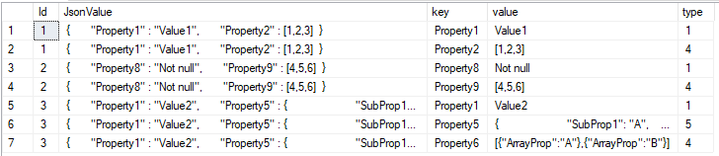
Tables: OPEN_JSON()
SELECT * FROM #ImportedJson
CROSS APPLY OPENJSON(JsonValue,'$')

Slide 7
Tables: OPEN_JSON()
SELECT * FROM #ImportedJson
CROSS APPLY OPENJSON(JsonValue,'$')

Slide 8
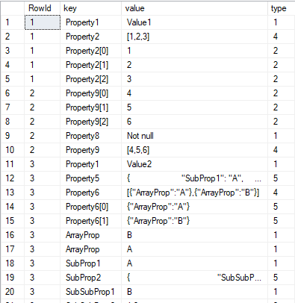
The All-In-One Parser
WITH JSONRoot AS (
SELECT
Id as RowId,
[key],
[value],
CAST([type] AS INT) AS [type]
FROM
#ImportedJson
CROSS APPLY OPENJSON(JsonValue,'$’)
UNION ALL
SELECT
RowId,
CASE WHEN JSONRoot.[type] = 4
THEN JSONRoot.[key]+'['+t.[key]+']’
ELSE t.[key] END,
t.[value],
CAST(t.[type] AS INT)
FROM
JSONRoot
CROSS APPLY OPENJSON(JSONRoot.[value],'$') t
WHERE
JSONRoot.[type] > 3 /* Only parse complex data types */
)
SELECT
RowId,
[key],
[value],
[type]
FROM
JSONRoot
ORDER BY
RowId;

